Slide 1
Hutterites and Their Notions of Health
By Derek Walde

Slide 2
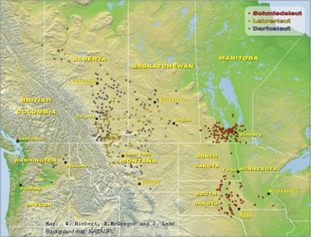
Location of Hutterite Colonies
2016 Census= 35,000 Hutterites living in Canada

Slide 3
Hutterites

Slide 4
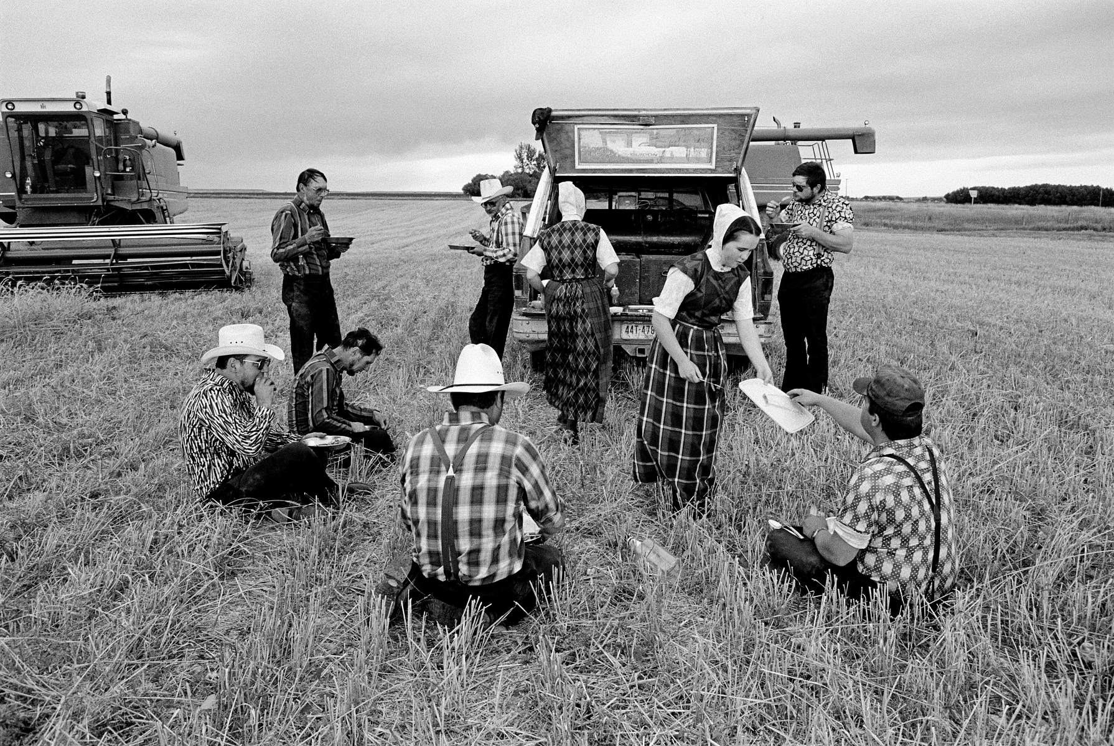
Hutterites
Live by Ana-Baptist teachings
Holy Bible is inherent word of God
Fundamentalist Christians
Three Characteristics of A Hutterite Lifestyle
Live communally
Non-materialistic, and simplistic
Culturally and geographically separated from society
“In the end all these beliefs and the adherence to a strict lifestyle, is to overcome temptations and never stray from the path of righteousness. The regulations are intended to combat selfishness, individualism, greed and the will to earn more.”

Slide 5
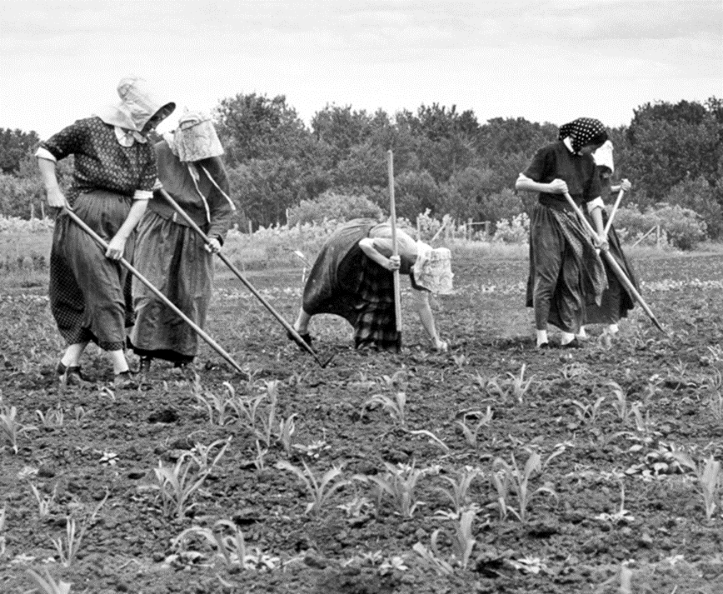
Medicalization In Hutterite Communities
The shift towards Medicalization in Hutterite colonies was driven by the pursuit to achieve:
A communal state of healthiness
To be a good worker for God and the colony

Slide 6
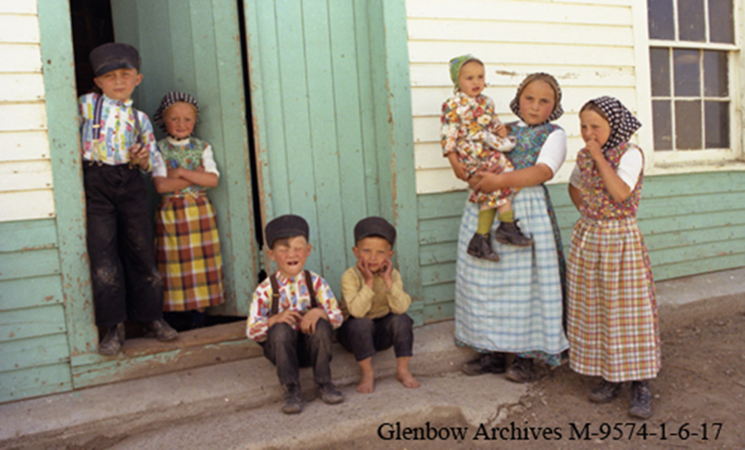
Death
Death is considered the most important moment in a Hutterite’s life, as it marks the entry into eternal life in Heaven.
There are 3 reasons for a positive view of death, based in religious doctrine:
Ritualized tradition in funeral services
Faith in an afterlife
Social Cohesion

Slide 7
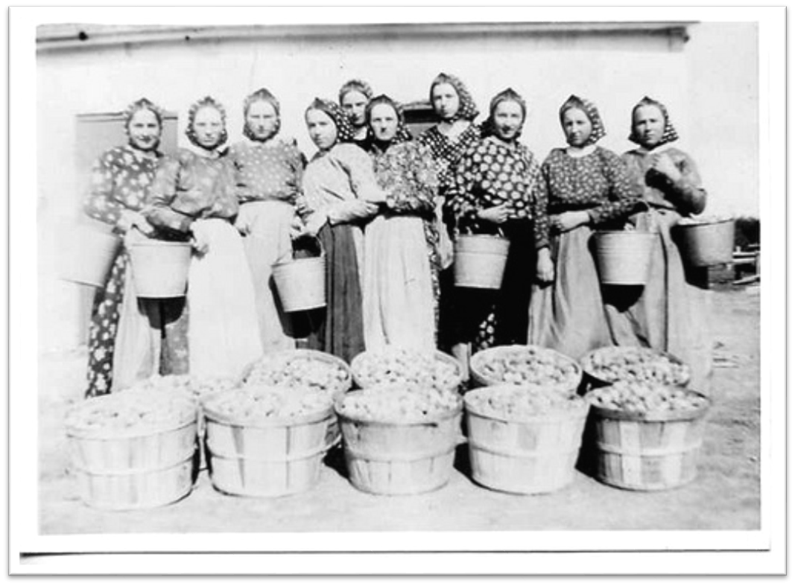
Mental Health
Mental health of Hutterites has been considered exceptional over many mental health studies
When Anfechtung, a mental/spiritual form of depression, arises it was dealt using:
Communalism
Religious Counselling

Slide 8
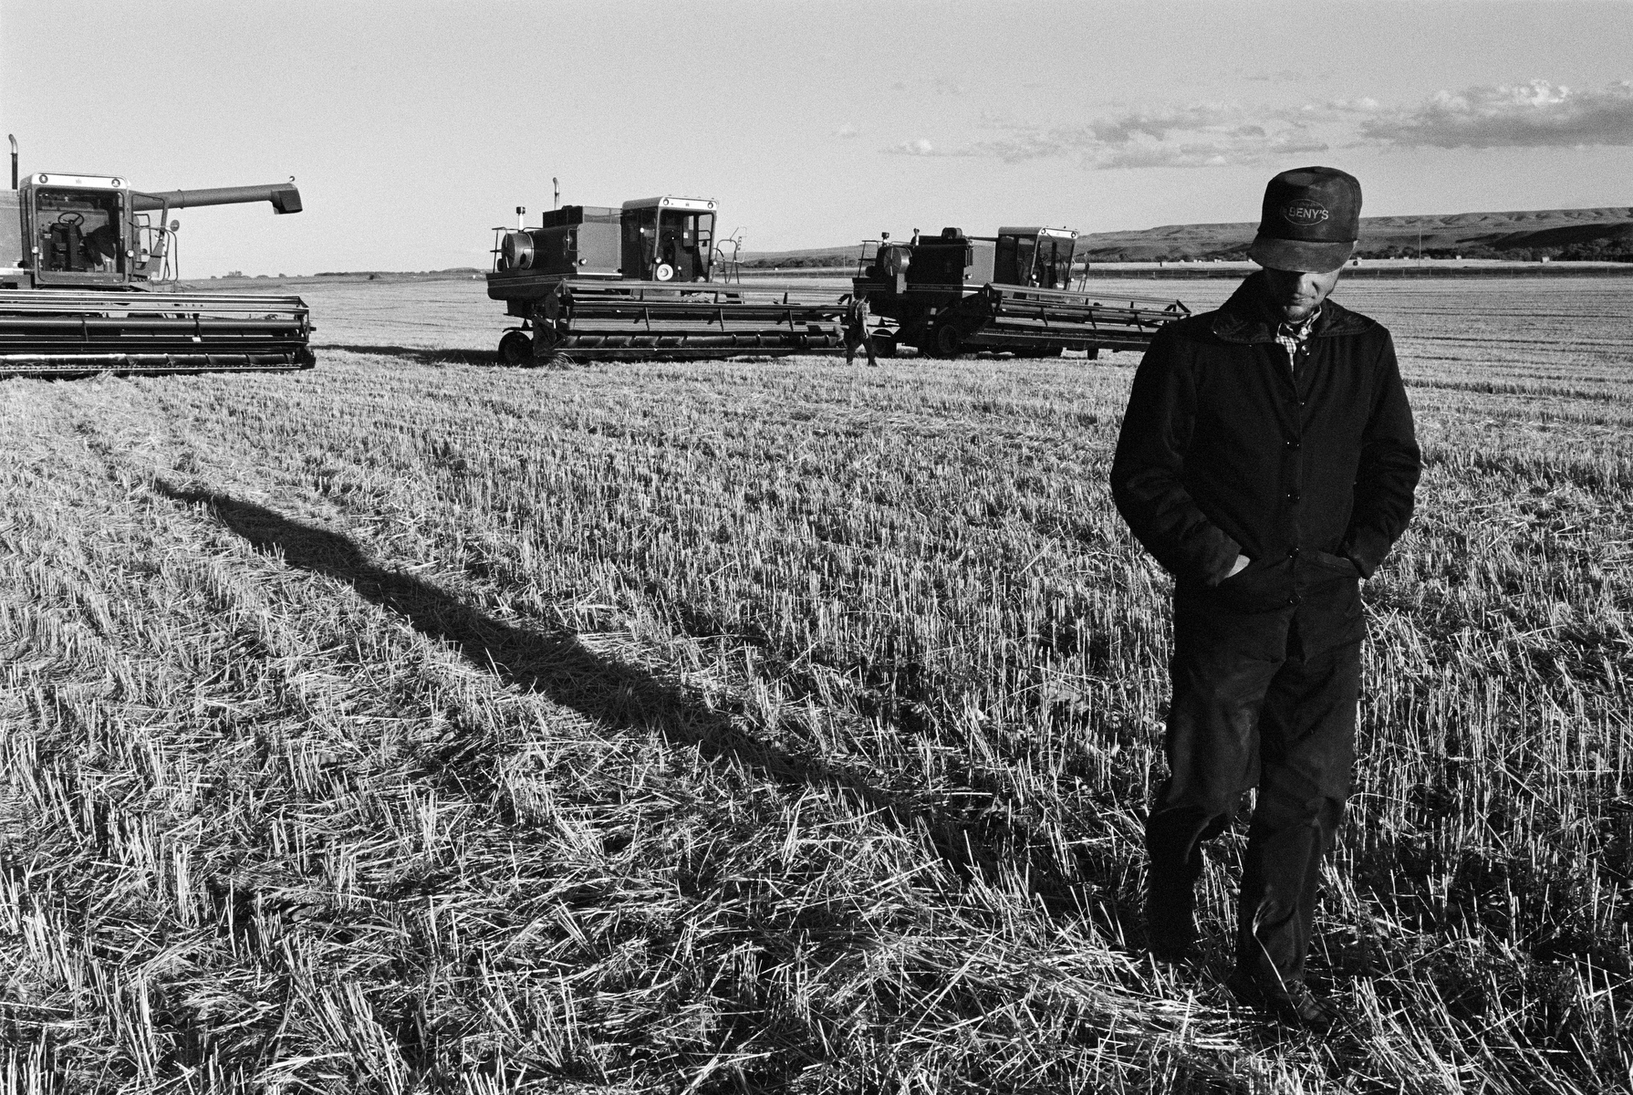
Conclusions
Hutterites’ unique religious beliefs creates a unique set of health notions
This shows that health is a social construction

